Slide 1

Bright Sparks Documentation

Slide 2
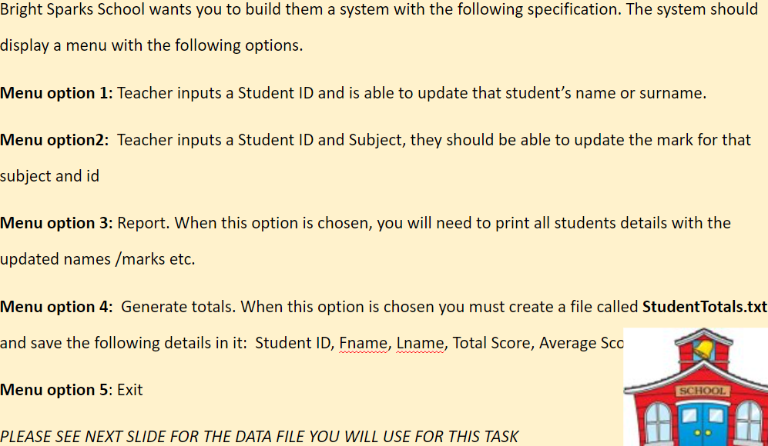
Brief

Slide 3
Criteria
5 functions with each menu option in
Ability to restart program within the program
Store all data in txt files
A home menu to pick from the 5 functions

Slide 4
ITERATION 1

Slide 5
Flowchart
https://lucid.app/lucidchart/6beb45ad-fdd0-43af-9f80-ba7eadaf52ad/edit?viewport_loc=-1617%2C-390%2C5450%2C2650%2C0_0&invitationId=inv_78aae857-7fc6-4087-9cc4-70406c981c6e

Slide 6
Commented code
https://github.com/Max-Hitchings/Bright-Sparks-School-System/blob/main/py_itterations/iteration1.py

Slide 7
Test plan
Menu option | Variable name​ | Test case​ | Test data​ | Expected ​ output | Actual Output​ | Action needed​
1, 2 | student_id | invalid | “S4” | "That student ID was invalid\nTry another one " | "That student ID was invalid\nTry another one " | Add error messages + retries
2 | subject | Boundary | “maths” | "What is the new mark?” | "Operation successful :)” | Remove case sensitivity
2 | student[i+1] | invalid | “Hello” | "You must enter a number" | "Operation successful :)” | Add error messages + retries
2 | student[i+1] | invalid | “S1” |  | "Operation successful :)” | It need to skip the student ID and names in the search

Slide 8
Evaluation
This code is okay however it doesn’t handle invalid inputs very well by either spiting out an error message or just not saying anything
This is what I will aim to improve in the next iteration

Slide 9
ITERATION 2

Slide 10
Flowchart
https://lucid.app/lucidchart/79aeca2c-18b4-458e-a617-ea32b3a1d8a3/edit?view_items=1tfoNpCx3MtO%2CzsfogpGSftnj%2C7rfo6~8fp9We%2C9sfoM6nFl45i%2Clsfo.plo2is7%2CWsfoc0i0_pVq%2CItfo7fip2cfZ%2C7tfoVlRChVd~%2C8sfoeTh61u4T%2Cksfo7F90BtFC%2CHtfoyY2_o2FV%2CZsfouiifFG9N&invitationId=inv_59790375-3b23-46fd-a491-6a85b64600f2

Slide 11
Commented code
https://github.com/Max-Hitchings/Bright-Sparks-School-System/blob/main/py_itterations/iteration2.py

Slide 12
Test plan
Menu option | Variable name​ | Test case​ | Test data​ | Expected ​ output | Actual Output​ | Action needed​
1, 2 | student_id | invalid | “S4” | "That student ID was invalid\nTry another one " | "That student ID was invalid\nTry another one " | Complete
2 | subject | Boundary | “maths” | "What is the new mark?” | "What is the new mark?” | Complete
2 | student[i+1] | invalid | “Hello” | "You must enter a number" | "You must enter a number” | Complete
2 | student[i+1] | invalid | “S1” | "You must enter a number" | "You must enter a number" | Complete
5 | N/A |  |  | Student leader board | N/A | Add the 5th menu option

Slide 13
Evaluation
I completed all my aims for this iteration by adding the necessary checks for inputs
Aim now is to add the 5th menu option

Slide 14
ITERATION 3

Slide 15
Flowchart
https://lucid.app/lucidchart/1ce7ca6a-0da2-42f6-bf68-3077a589e72a/edit?viewport_loc=1559%2C-309%2C3150%2C1532%2C0_0&invitationId=inv_9d5901c0-1845-4d7a-9162-f642b4002751

Slide 16
Commented code
https://github.com/Max-Hitchings/Bright-Sparks-School-System/blob/main/py_itterations/iteration3.py

Slide 17
Test plan
Menu option | Variable name​ | Test case​ | Test data​ | Expected ​ output | Actual Output​ | Action needed​
5 | N/A | valid | totals.txt file exists | Sorted list | Sorted list | N/A
5 | N/A | Invalid | totals.txt file doesn’t exist | "please use option 4 before using this option" | "please use option 4 before using this option" | N/A

Slide 18
Evaluation
I completed all my aims for this iteration by adding the 5th menu option so It went quite well

